Slide 1
Preserving the integrity of information Online: Propaganda Tool Extension
Mustafa Alfaouri, Cybersecurity MS Candidate

Slide 2
Introduction
Computational Propaganda has greatly affected society on an international level.
Communities around the world have been more polarized as a result of the propagation of misinformation.
Most people cannot determine the intent or authenticity behind the information they consume and as a result accept much of what they read at face-value.
Many experts now refer to this social landscape as a “post-truth” one. Which is deeply concerning.
Fortunately, in recent years, researchers, academics, and others have come together to combat misinformation, in the forms of spreading awareness through articles, data models, and applications for both researchers and common users alike.
The tools that will be focused on are browser extensions that give users more insight into what information they are viewing.

Slide 3
Background
There are quite a few chrome extensions that give insight into what users are reading. Some of them reference a database of known sites to determine the objectivity of a link or article, others look at keywords to determine the objectify of an article.
The methods that this information is conveyed could be a numeric scale rating, from 1 to 5. 1 being the least objective and 5 being the most. Others simply append a bias label to the link like “far-right, far-left, pro science, and conspiracy”.
While all these methods seemed effective, there was one piece that seemed absent, in these tools. What are other users’ stance on the ideological spectrum, particularly the one’s viewing the article at the same time as a user?

Slide 4
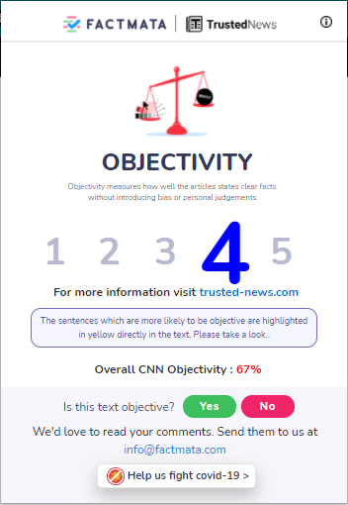
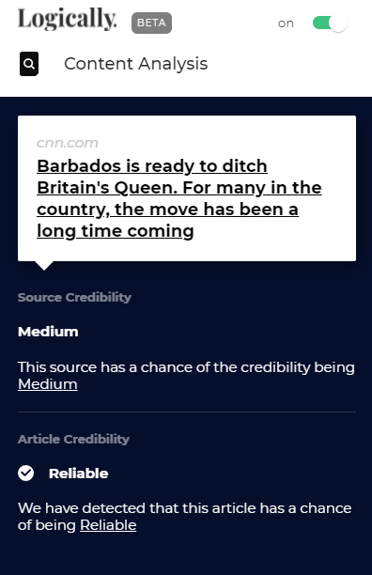
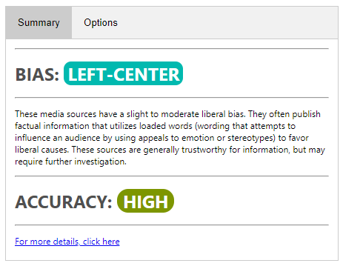
Background: Extension Examples
Stopaganda Plus
TrustedNews
Logically

Slide 5
Concept of PropTool
To give a user insight about what kind of information other users viewing the same page as they are consuming on average.
This should cause a user to think more critically of what they are reading.
For example, there may be an article on associated press which is one of the least likely outlets to contain propaganda may be opened and read by a lot of users that have a high propaganda score, which would in turn drive up the score of the page being viewed, which would be unusual, but not impossible for an outlet like associated press.
This concept can be applied in the real word using users’ browsing data and determining the propaganda rating of each site they would go on to consume news and other information.
An average propaganda score for a collection of users would then be shown to a user viewing the page, giving them insight into the type of content other users consume on average.

Slide 6
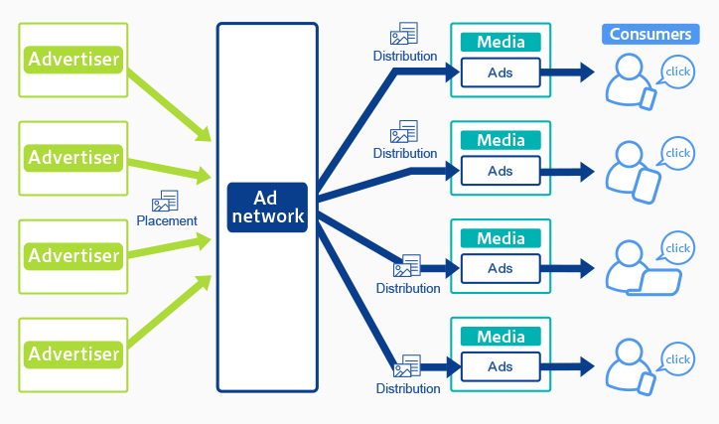
The Advertising Model

Slide 7
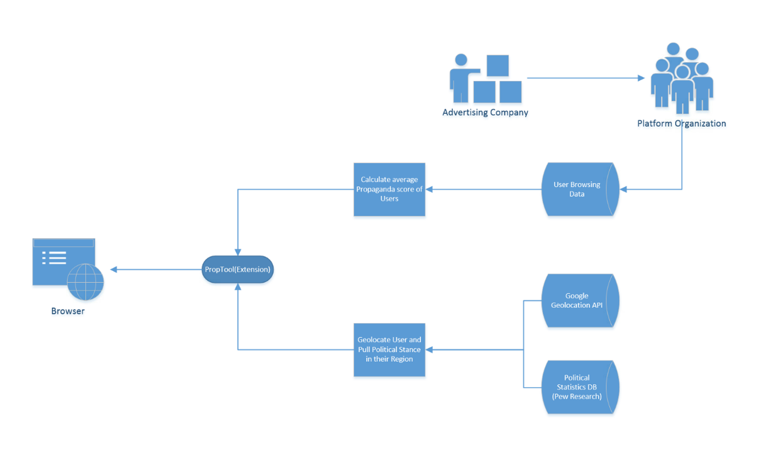
Data Flow Diagram of PropTool

Slide 8
Chrome Extensions Vs. Web Applications
Web apps offer a more comprehensive infrastructure, with a lot of capability, complexity. There are many tools online in the form of webapps and would be much easier to make since there are so many resources in today’s age that allow you to figure out what is required to achieve your goals in developing a web application.
Extensions have been around for some time but due to their nature, they are not meant to be as complex as a web application.
Browser extensions are meant to run on top of a webpage and interact with it in some way. Fully understanding this difference in implementation and development.

Slide 9
Chrome Extensions Vs. Web Applications (cont.)
Extensions have a json file called the manifest, this serves as a header for the extension. This Manifest.json file is required for the extension to be loaded.
Parameters for the extension are specified in the extension.
If certain parameters are missing, the extension will not load into the browser.
Some parameters include name, version, manifest version, content scripts, permissions, and many other optional parameters that can be found in Google and Mozilla’s extension documentation.

Slide 10
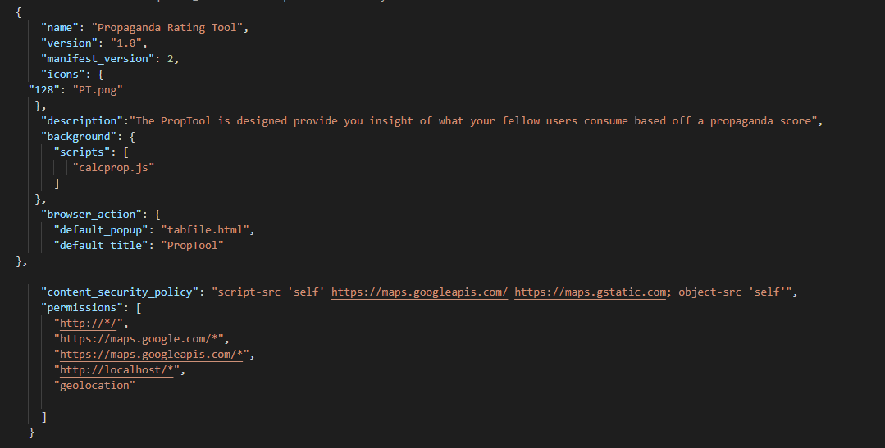
PropTool Manifest File

Slide 11
Development Overview
With extensions relying heavily on JavaScript, I did not know where to begin, I looked for ways to implement a sort of backend but going back to the concept of how an extension works and that they are not 1:1 equivalents to conventional webapps.
After weeks of research and finding no straightforward way of I then began to investigate API calls and how I could utilize those as a sort of backend substitute to add some dynamic behavior to the chrome extension. I imagine that many chrome extensions that I had looked into utilize similar methods in their functionality to produce their results.

Slide 12
APIS
An API or Application Programming Interface is a connection between your program and another over an http connection.
APIs have become really popular in recent years, allowing for new sources of revenue for companies like google and others.
It has allowed people to develop applications with more capability and efficiency. Understanding how to use APIs in programming is essential knowledge in today’s industry.
Some APIs are open source and allow unlimited calls while some organizations like google give a certain number of free calls and charge for each call beyond that point.
If you ever see a google maps widget being used on a website unrelated to google, the developers of that platform are calling the Google Maps API. You can get an idea of how much revenue is probably made from other web platforms using Google APIs, which get called every time the page loads.

Slide 13
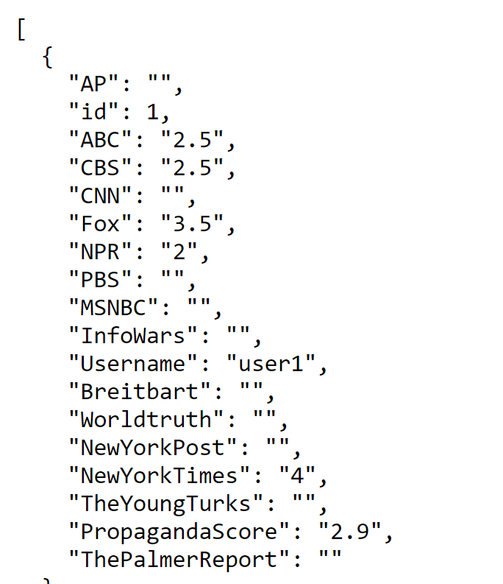
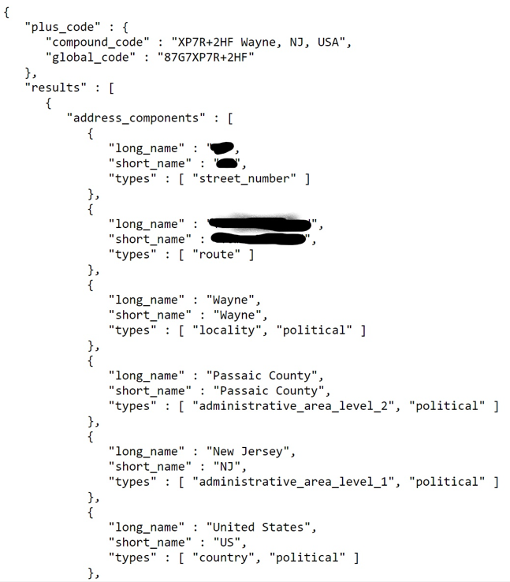
API Calls
API calls are done through an HTTP request and the data is recalled is a json format shown here:
Retool CSV API (Left)
Google Geocoding API (Right)

Slide 14
Functionality: CSV API
The retool API is an open-source CSV API that allows you to upload a CSV and generate an API that allows you to call upon the data from the CSV.
The API is designed to allow row by row calls, which made it convenient to simulate pulling user data from the CSV.
For example, the dataset is called proptool so making the following http request: https://retoolapi.dev/DmVDy5/propdata/ it will return all the data in the csv in JSON format.
Adding a 1 or any number between 1 and 25 after the slash following propdata will return that row of the CSV in JSON.

Slide 15
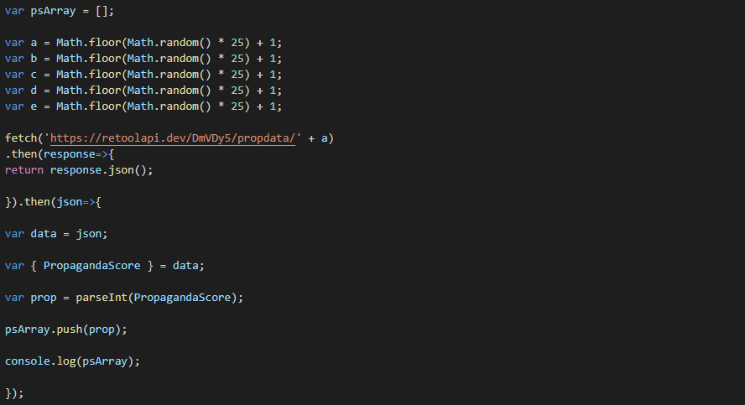
Functionality: CSV API
5 variables (random numbers between 1 and 25) are declared that are appended to the end of 5 separate calls for the CSV API.
After each call, the propaganda score of each row is extracted and pushed into an array declared at the beginning.
Those values are then averaged out and final value is displayed on the extension.

Slide 16
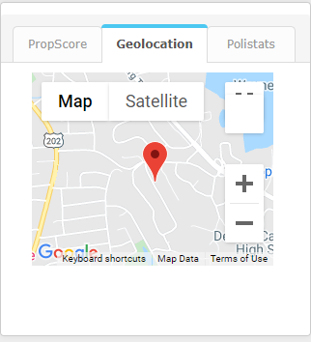
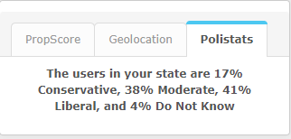
Functionality: Geolocation function, Google Maps Geocoding API and Political Affiliation CSV API
Using the navigator function in JS, it allows a user to pull their longitude and latitude in real time.
The longitude and latitude are then injected into the geocoding api call for Google’s geocoding API which returns a wide variety of information including State, city and street address of the coordinates.
Using the coordinates, the location is also reflected in a google maps object shown in the second tab of the extension.

Slide 17
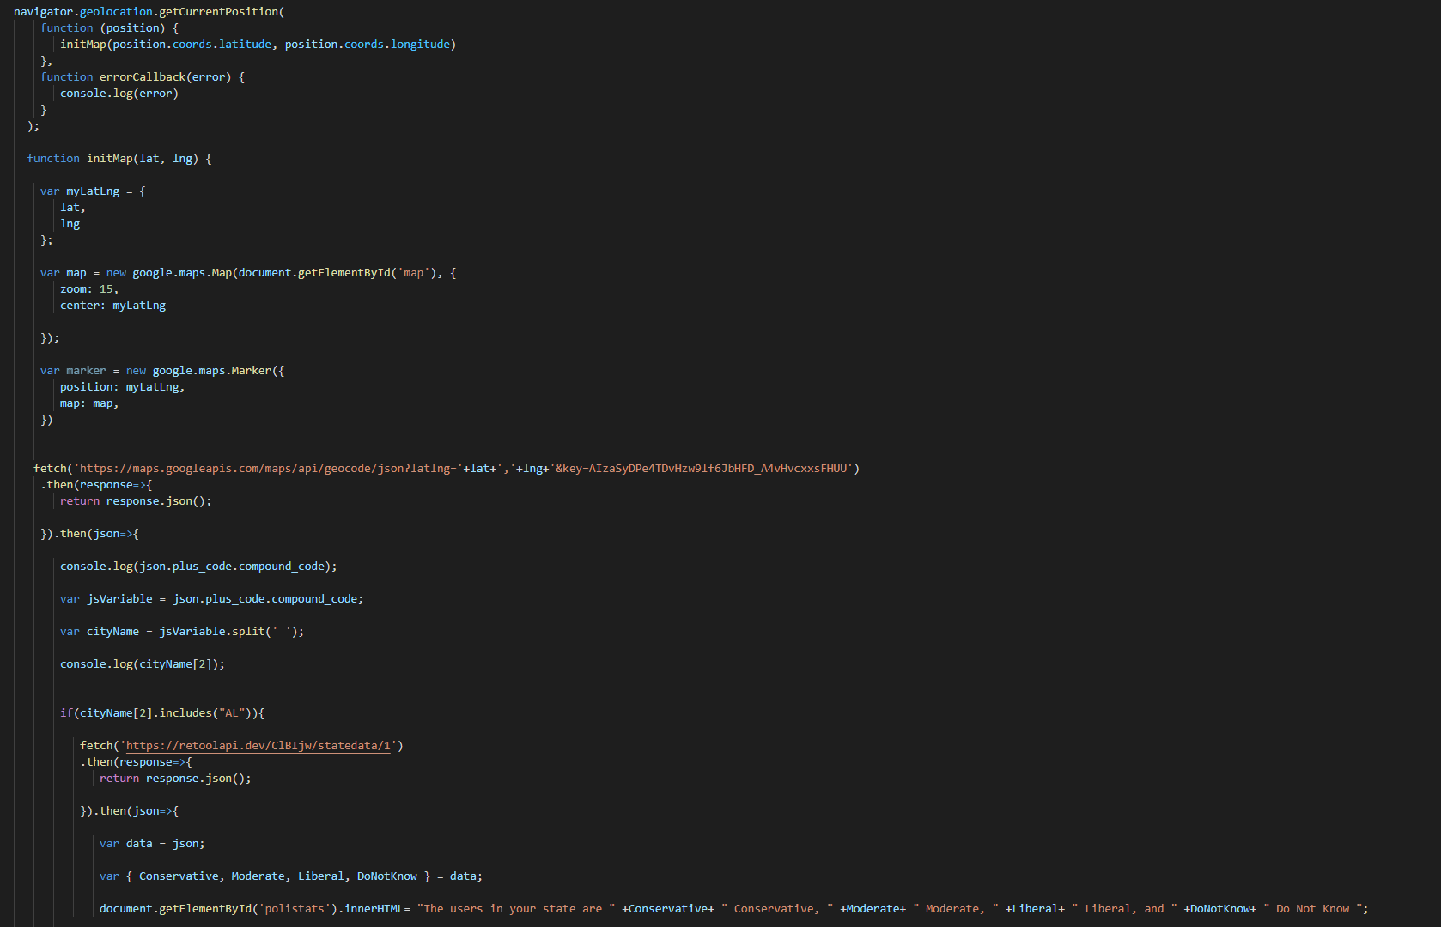

Functionality: Geolocation function and Google Maps & Google Geocoding API
Geolocation Functions Pulls the Longitude and Latitude of the user.
Initmap function sets the map and marker of the user’s location on the popup page of the extension.
Those coordinates are then passed into the Geocoding API.

Slide 18
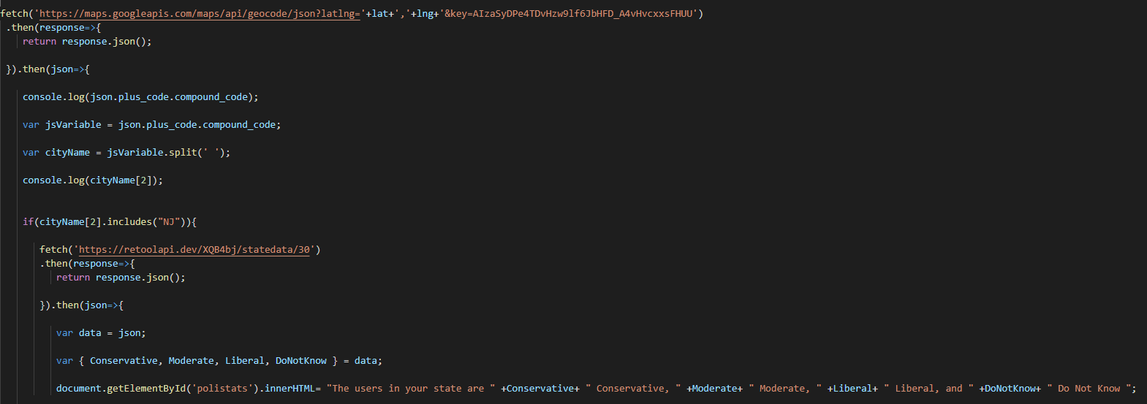
Functionality: Political Affiliation CSV API in conjunction with Google Geocoding/Maps API
Extracts City/State of user based off Coordinates.
Compound_code is a JSON object in the API that is a string of alphanumeric characters followed by the city and state.
split by the spaces in the value and single out the city and state which is always cityName[2].
If cityName[2] contains a certain state abbreviation, display the political affiliation info of that state in the extension.

Slide 19
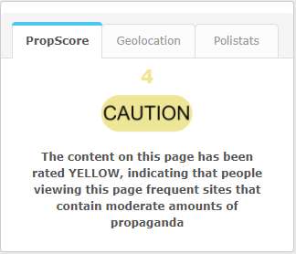
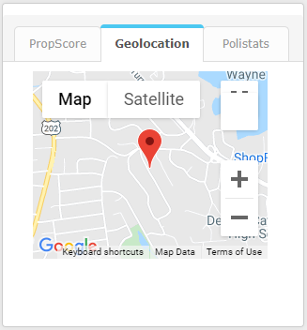
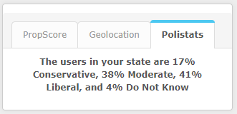
User interface and Final Product

Slide 20
Learning Curves During Development
Understanding the differences between browser extensions and webapps.
The limitations browser extensions have as opposed to conventional webapps.
Learning about how APIs work how they can be called, and how to extract and manipulate data from them.
The browser extension manifest file, its parameters and content security policies.
Learning JavaScript and JSON at a moderate level.

Slide 21
Issues During Development
The extension returning “NaN” or Not a Number constantly when the application is run, some tweaks had reduced this but after some debugging, it has been determined that this is a bug with the CSV API itself.
Figuring out how to randomly choose 5 propaganda values from the csv and return it on the application in a clean manner with JS. A for loop was attempted at first but new variables were not being read outside of the loop, most likely had to do with the API call. The only solution was five separate calls.
Getting a tabs UI to work properly in the extension, inline JavaScript is not allowed in chrome extensions because of the content security policy.

Slide 22
Issues During Development (cont.)
Getting the google maps API to run in the extension. A specific content security policy had to be written in the manifest file. No straightforward answers were found on official documentation or stack overflow. I eventually did find something on stack overflow but it took some digging.
All the code was originally tested as a webapp before importing it as an extension into the chrome browser.
Much of what was achieved required a lot of trial and error, as all programming does.

Slide 23
Next Steps?
Implementing some elements that interact with keywords on an article or content page.
Have a propaganda score that constantly refreshes since users navigate in and out of a page in real time. I believe this is possible with AJAX.
Attempt to eliminate the NaN bug, this was definitely a bug from the retool CSV API.
Implement “Polistats” on a town or county level, which may be impractical considering the number of towns and counties in the country, but it would be more ideal.
A much cleaner UI, with more visualizations. There are a lot of css packages that people make that can be called upon in a CSS file that can make a UI a lot nicer. There are always new features added to later versions of CSS as well.

Slide 24
Link Citations
UI based off:
https://speckyboy.com/10-simple-code-snippets-creating-beautiful-tabs/
Pew Research Datasets:
https://www.pewforum.org/religious-landscape-study/compare/political-ideology/by/state/among/party-affiliation/democrat-lean-dem/
Pew Research Datasets, Wyoming and Kansas:
https://www.pewforum.org/religious-landscape-study/state/kansas/political-ideology/
https://www.pewforum.org/religious-landscape-study/state/wyoming/political-ideology/

